Slide 1


Rostering in a pharmacy department
An experiment in workplace rostering using Linear Integer Programming & optimisation modelling techniques

Slide 2



Meet our team
Kipp Hughes
Mathematical Modelling Major
Passionate about education
Active Musician
Chris Swan
Mathematical Modelling Major
Love of problem solving
Creative writer

Slide 3

Our Client
Monash Medical Centre Pharmacy Department
Andrew Chong
Assistant Deputy Director of Pharmacy
Jeff Davies
Senior Pharmacist
Intern Program Coordinator

Slide 4
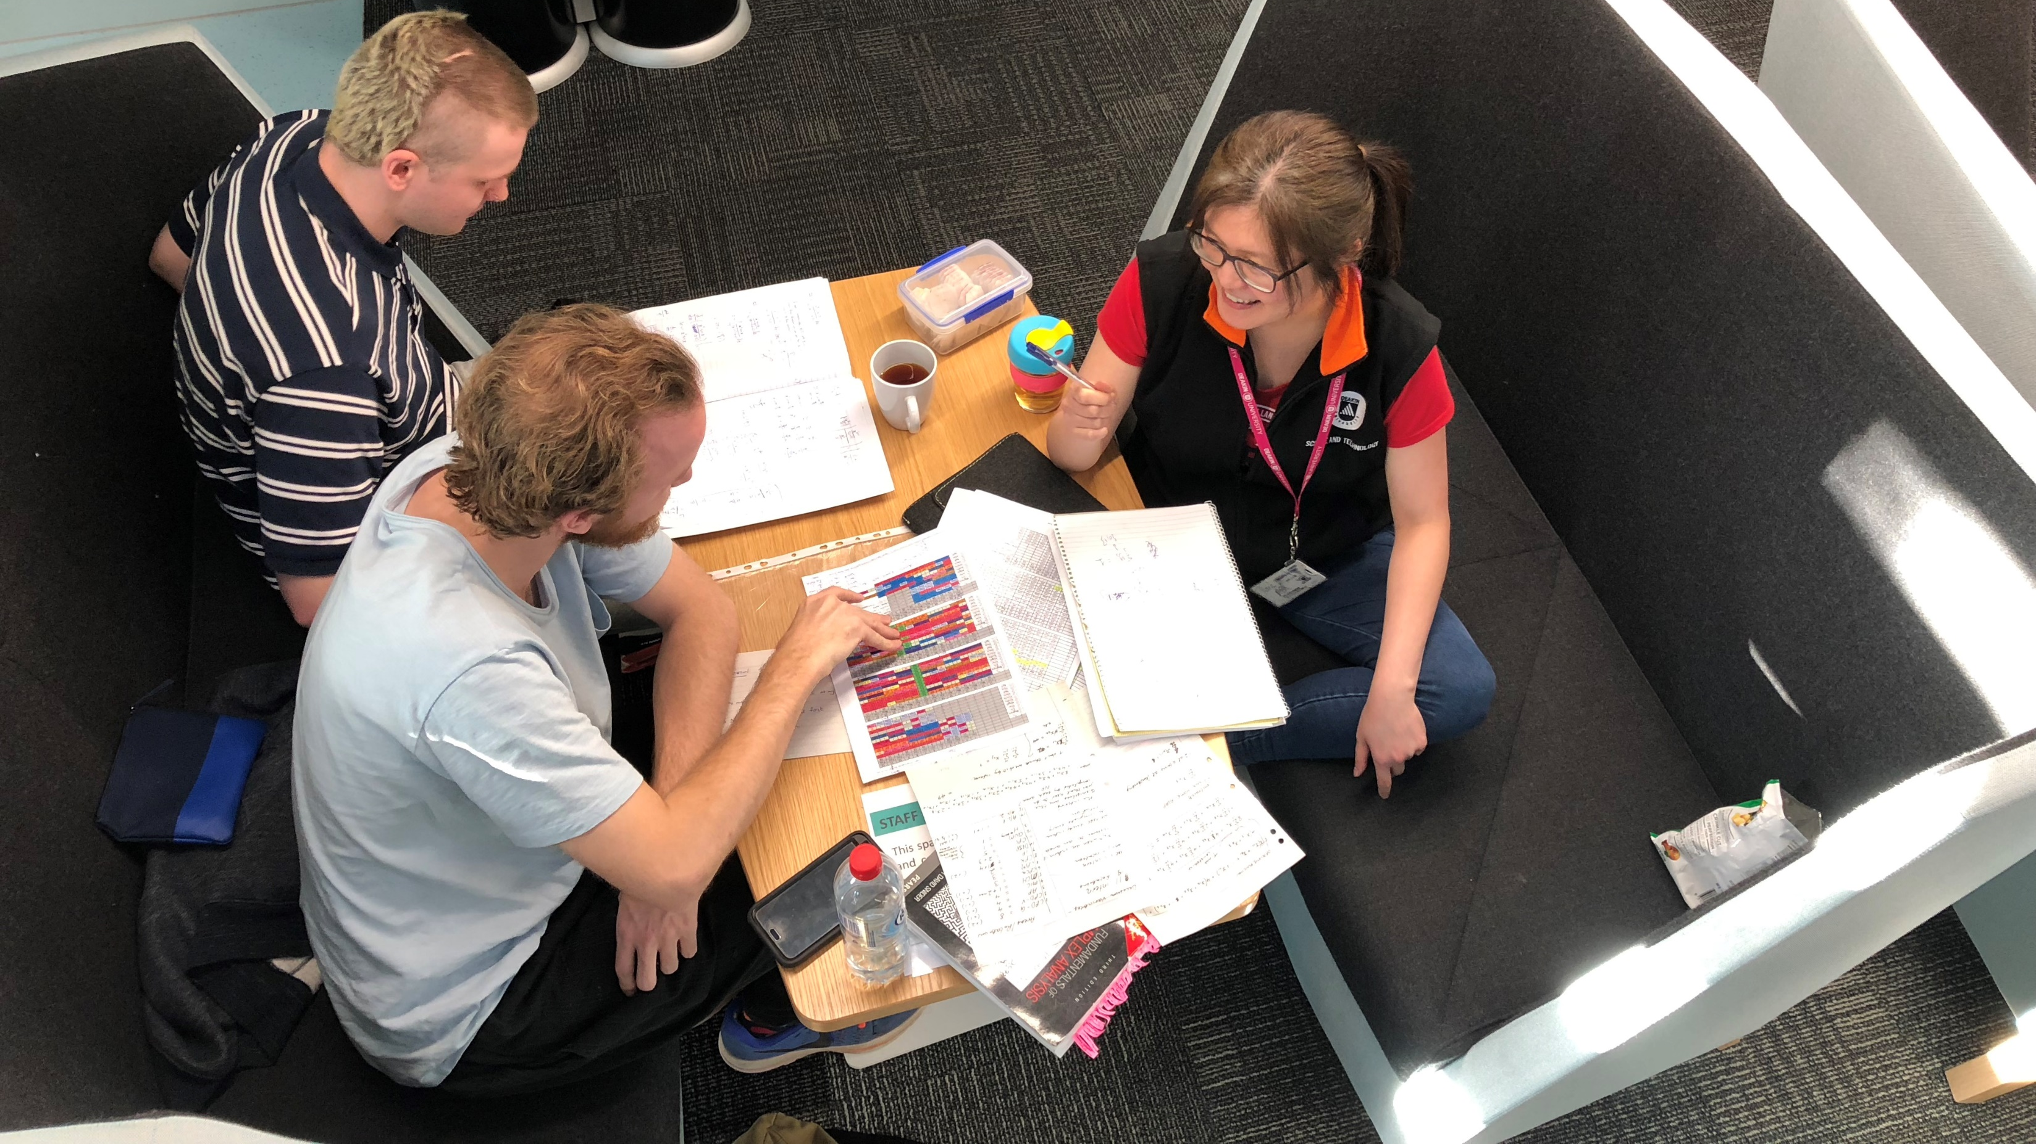
In the beginning…

Slide 5

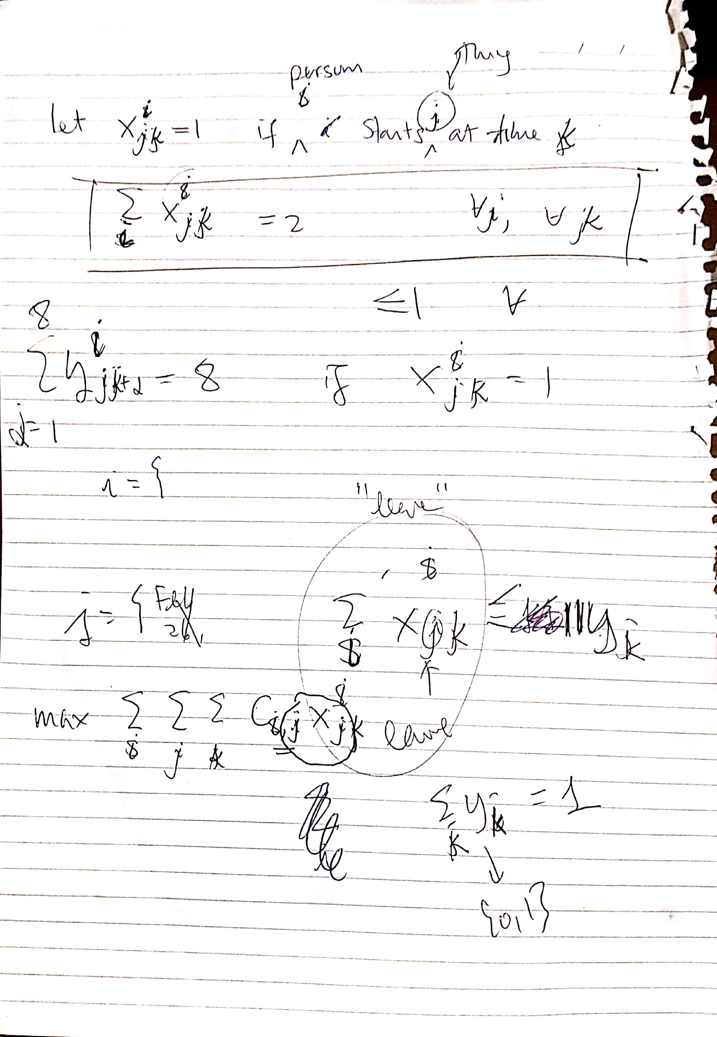
Our Project

Slide 6
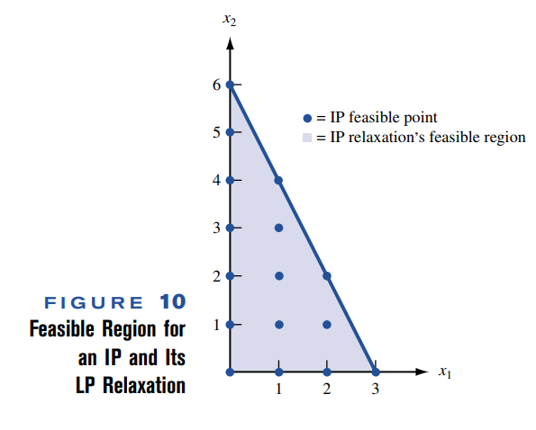
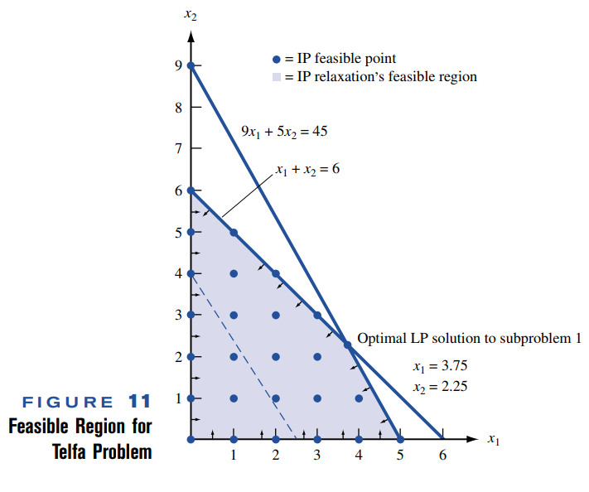

Slide 7

What is Linear Integer Programming?
Problem solving using systems of linear equations that describe real world constraints to solve an objective function
Binary and Decision Variables (dvar Boolean)
$x_{j,k}^{i}=1$ → intern $i$ is doing rotation $j$ in week $k$.

Slide 8
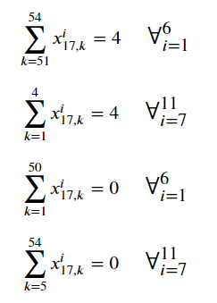
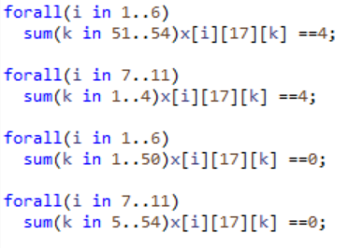
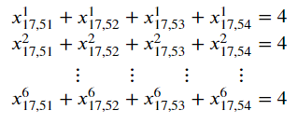
Staggered start

Slide 9
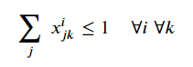
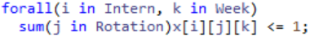
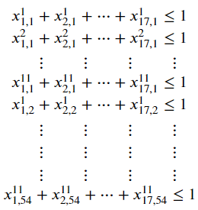
Physical constraint

Slide 10
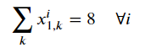
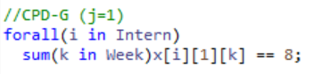
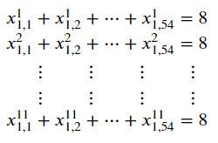
Rotation completion constraint

Slide 11
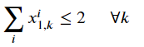
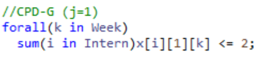
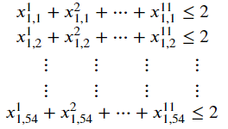
Rotation capacity constraint

Slide 12
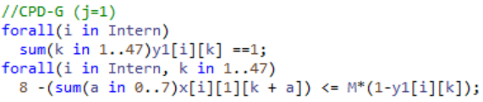
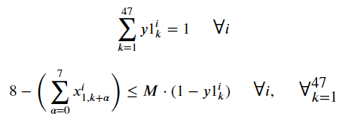
Duration constraints

Slide 13
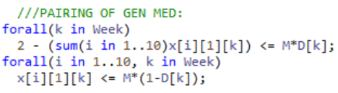
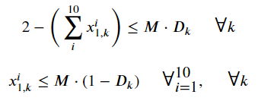
Parity of CPD-G rotations

Slide 14
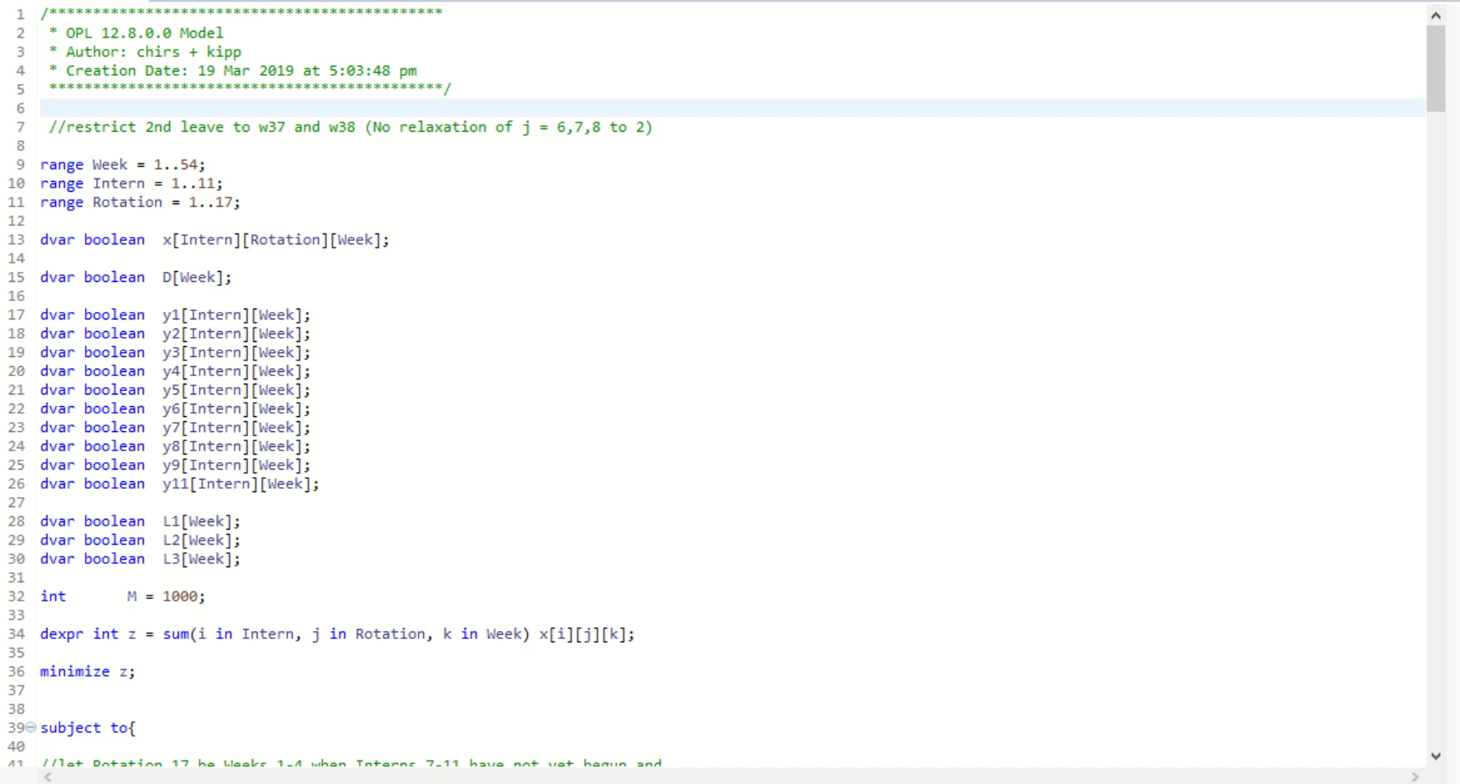
V7.9

Slide 15
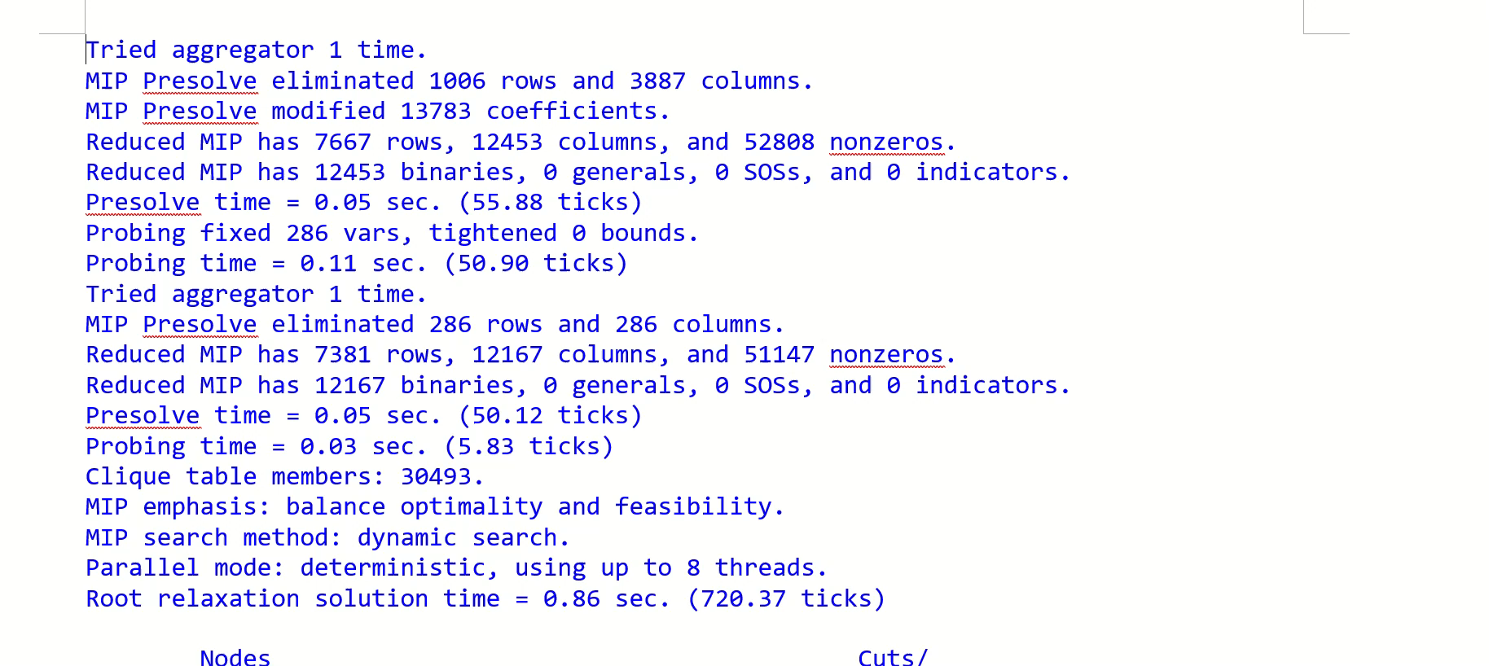
v7.4

Slide 16
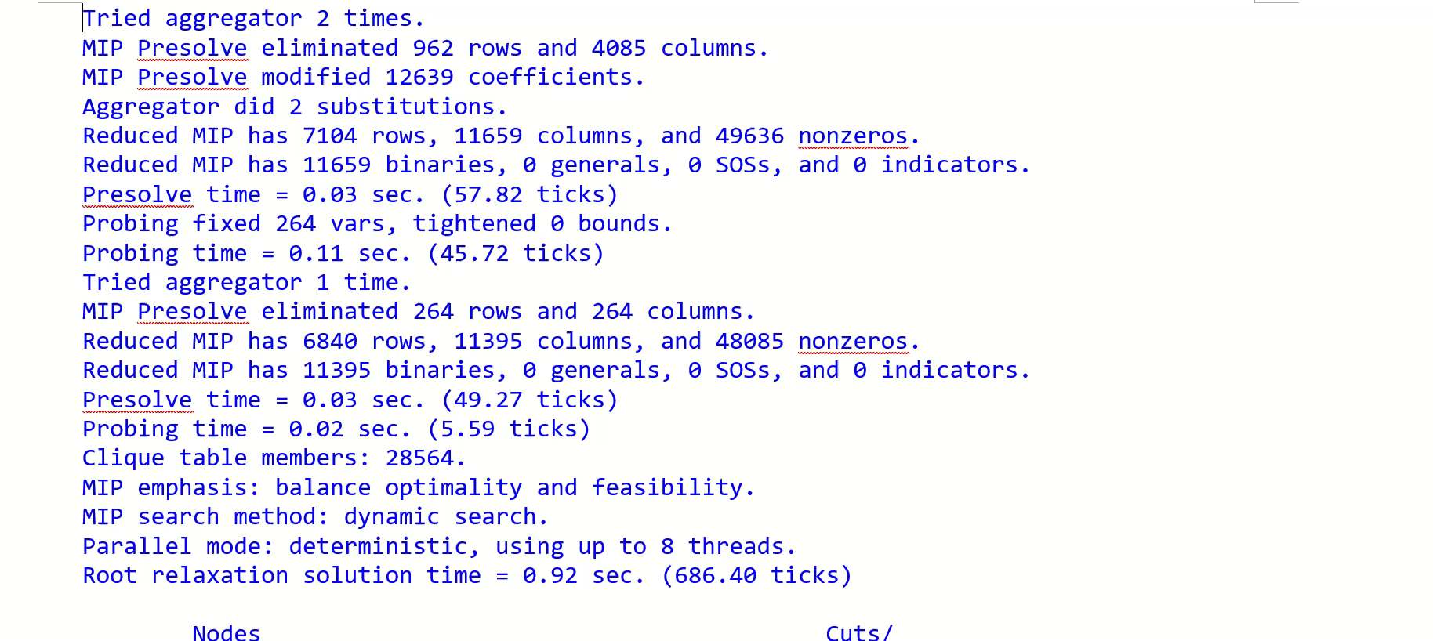
v7.9

Slide 17
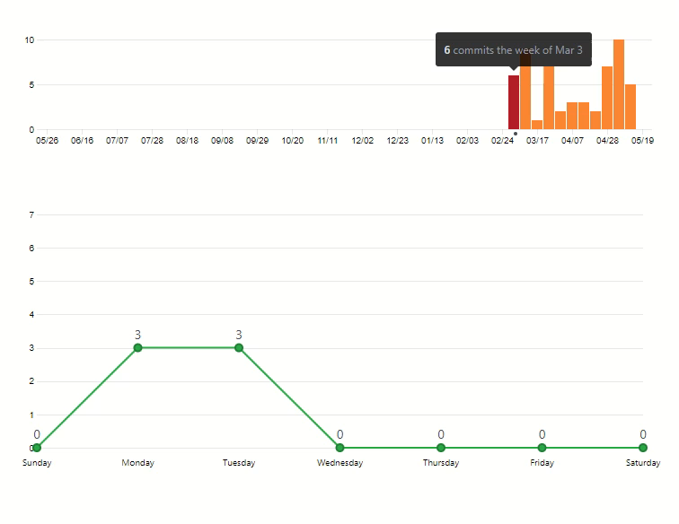
Push summary

Slide 18
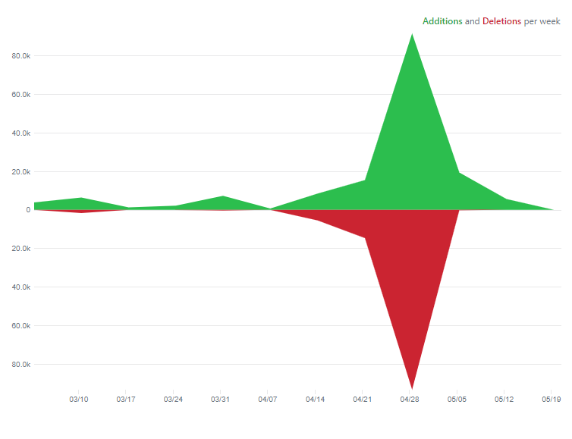
Github Code summary

Slide 19
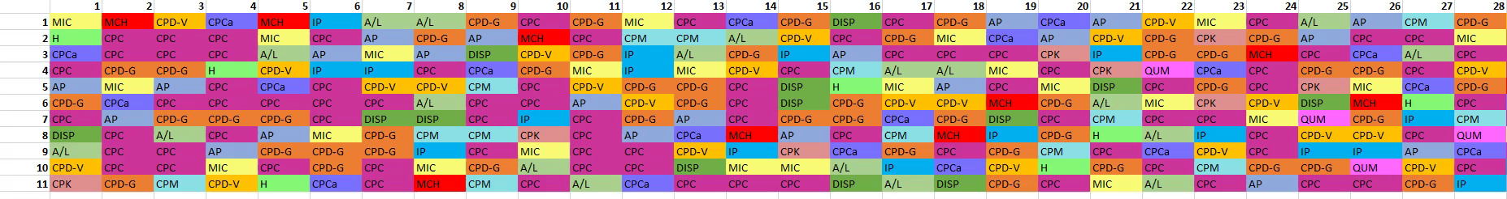
V1.0

Slide 20
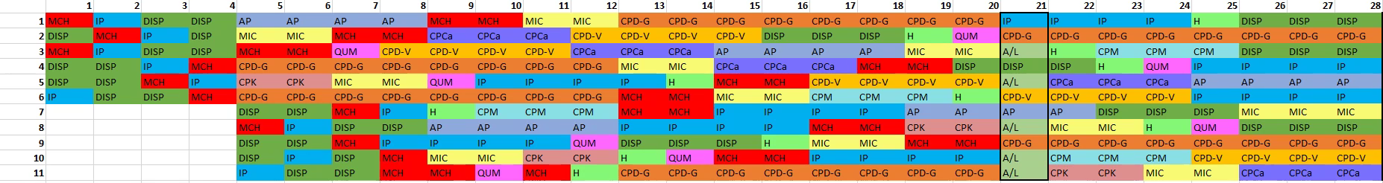
V5.3.1

Slide 21
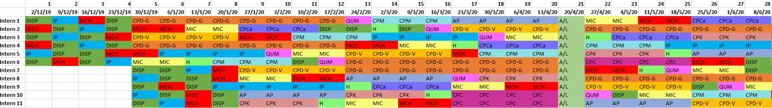
V7.3

Slide 22
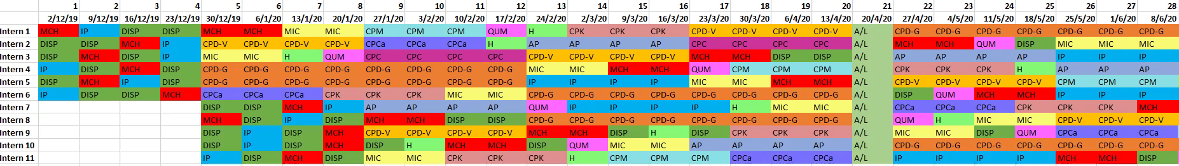
V7.9

